Slide 1
Commitment Institutions and Electoral and Political Instability
Isaac Liu

Slide 2

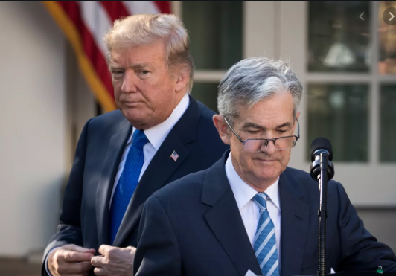
Do the commitment institutions of central bank independence and fixed exchange rates affect electoral and political instability?
Net Welfare Benefits
Inflation Time Inconsistency
Political efficacy, access to capital
Economic Voting, Increased Stability
Political Business Cycles
Inability to manipulate economy or satisfy partisans
Monetary (perhaps fiscal) policy
Economic voting, Decreased Stability

Slide 3
Literature
Bernhard and Leblang (2002)
OLS, 16 parliamentary democracies since 1970s
CBI increases cabinet duration by 3mos, Fixed rates by 5mos
Clark, Golder, and Poast (2013)
Survival Analysis, 19 OECD countries since 1970s
Both institutions decrease leader survival but only after 7y in office
Contribution:
Far larger dataset including non/semi-democracies
More consideration of endogeneity: choice of institutions based on stability consideration, de jure independence
Political, not just electoral stability (coups, civil wars, etc), consideration for specific governmental positions

Slide 4
Data
Panel of 192 countries, 1970-2016
Varieties of Democracy
V2elturnhos, v2eltturnhog, v2eltvrig
0 for same individual, 1 for same party or coalition, 2 for new party & ind.
WGI Political Violence (neg = unstable)
Instability Event- coup, civil war, internal conflict
Garriga (Cukierman, Webb, Neyapti)- de jure CBI
Dreher et al.- Irregular turnover of governor- de facto CBI
Reinhart, Rogoff Exchange Rates: 16 categories (higher = float)

Slide 5
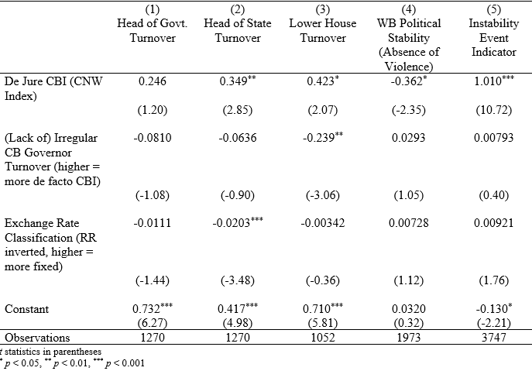
Results
FEs, clustered SEs
De Jure CBI and more instability: PBCs
De Facto CBI (less irregular CB turnover) and less lower chamber turnover
Fixed rate, less HOS turnover
Welfare Benefits of De Facto CBI, Fixed Rates?

Slide 6
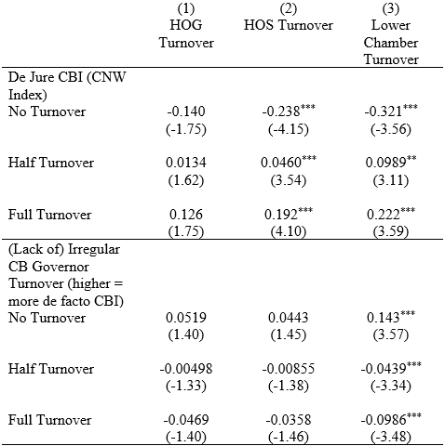
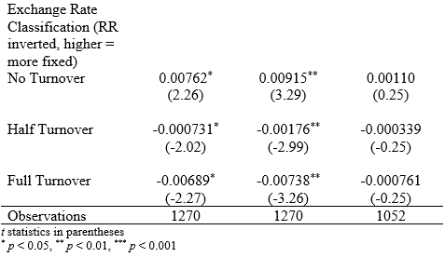
Ordered Logit (Mean Marginal Effects)
Nothing changes in terms of significance, except for fixed Erates and HOG
xtologit; random effects

Slide 7
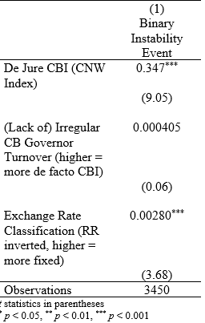
Panel Logit (binary instability event variable) Mean Marginal Effects
Fixed effects
More evidence that de jure CBI increases political instability
Fixed exchange rate (low RR rate) increases pol. instability, but very small effect size

Slide 8
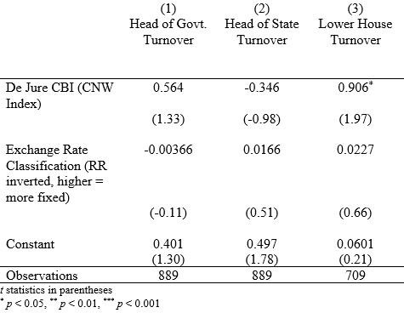
IV1: Tertiary Ed Enrollment (CBI), Aggregate GDP (Fixed Rate)
Good first stages
Poor exclusion restrictions for political stability, better ones for electoral stability/turnover
De jure CBI now increases lower chamber turnover, but no longer HOS
Unclear sign for fixed rates
De facto CBI omitted, insignificant

Slide 9
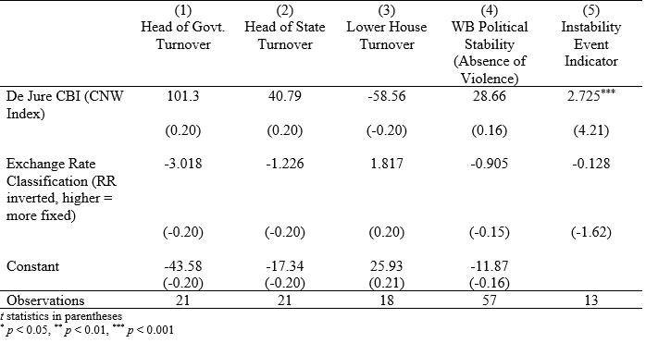
IV2: Population Share Social Science/Business Grads (CBI), Agg GDP (Fixed Rates)
Better Exclusion Restriction
Very limited data but strong result for de jure CBI and political instability

Slide 10
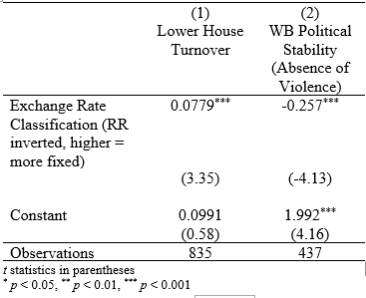
Just Aggregate GDP for Fixed Rates
Clearer case for fixed rates decreasing pol and electoral stability (PBC)
Note on exclusion restriction: still an imperfect case
Agg GDP proxies for economy size (optimum currency area)
Arguably not as connected to GDP per capita to stability
Result for LH sensitive to dataset

Slide 11
Table of Lags
Irregular central bank turnover instantaneously associated with lower chamber election turnover
T-3 sees strongest de jure CBI political instability impact
T-6, T-8 de jure CBI increases pol instability. T-8 reduces HOG turnover (electoral instability) (similar to Clark, Golder, and Poast).
Fixed rates increase instability in the same T-6 and up range
Little significance for de facto CBI/governor turnover
Contact me if you want to see this result

Slide 12
Summary
De jure CBI generally decreases (esp. pol) stability, suggesting limits on PBCs
Sign unclear for governor turnover/de facto CBI
Fixed exchange rates also increase electoral stability, but decrease political stability in FE & XTLogit models
In IV and lag specifications fixed rates decrease all stability
Commitment institutions politically costly, at odds with some of the literature
Robust results
Not covered: capital controls/openness don’t matter, binary independent variables somewhat reduce effect sizes, interactions with democracy do not matter, institutional controls for federalism and corporatism do not affect signs or cause large changes in effects

Slide 13
Questions/future directions
Diverging predictions for Head of Government, Head of State, Lower House Turnover
HOS and Lower House seem to have strongest relationships
Endogenous elections
Exchange rate classification as categorical variable, not continuous (although already did binary)
Dynamic panel (A-Bond)?
Ordinal logit regression with IV (different procedure)
Ordinal logit with lags

Slide 14
Additional Results/Checks

Slide 15
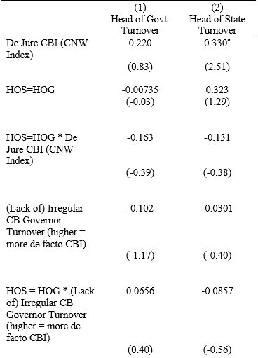
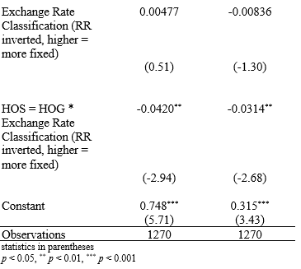
HOS = HOG?
V2exhoshog is an indicator for whether HOS and HOG are the same person
De jure CBI increases HOS turnover somewhat more when they are not the same person ???
Weaker effect when they are
Fixed erates reduce turnover in when they are the same person

Slide 16
Binary Dependent Variable (xtlogit)
Two codings, similar results
Fixed effects
Floating (versus fixed) rate now also increases WB political instability index
Contact me if you want this

Slide 17
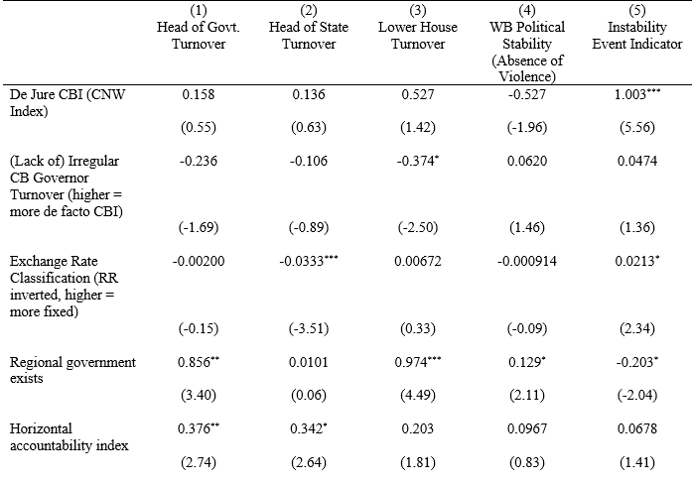
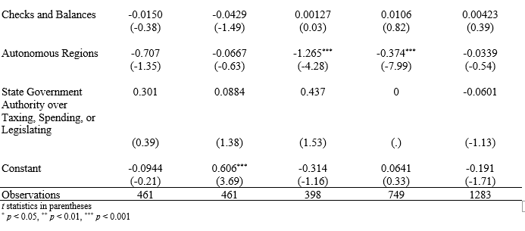
Controls
Regional government exists and has autonomy and authority, checks and balances/horizontal accountability
Not strictly necessary
FEs
Significant controls, but also no sign flips in key vars
Omitted: Corporatism
Collinearity?

Slide 18
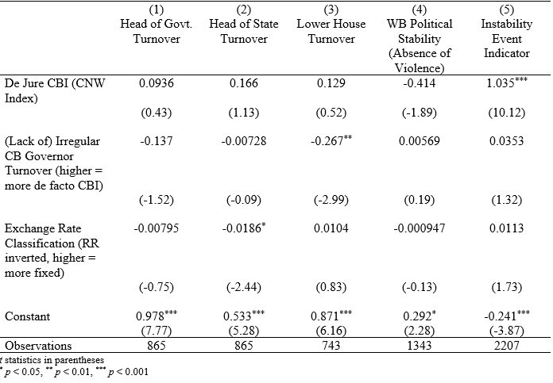
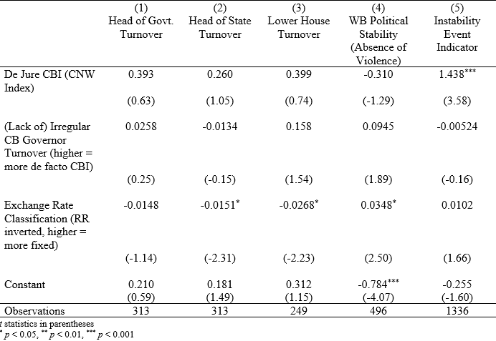
Democracy/Nondemocracy
High polity on the left, low polity on the right
De facto CBI (less irregular turnover) means less lower chamber turnover in democracies but reverse in autocracies. Rule of law?

